Slide 1

Pizza Sales Analysis
Data Analytics with Advanced MySQL
Presented By : Anshul Maggu

Slide 2

About Project :
As a Data Analyst at Target Sales Company, my role is to analyze and extract valuable insights from a diverse dataset comprising orders, customers, products, and operational metrics The objective is to support the company's strategic decision-making by identifying key trends in sales performance, customer behavior, and operational efficiency. This project covers advanced SQL data extraction

Slide 3

SQL Analysis –
Advanced Queries

Slide 4
Basic Queries

Slide 5
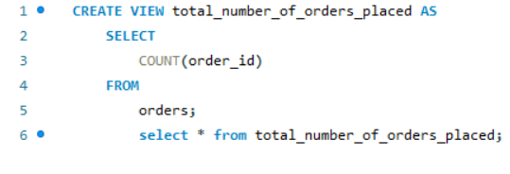
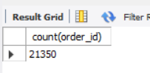
1- Retrieve the Total Number of Orders Placed.

Slide 6
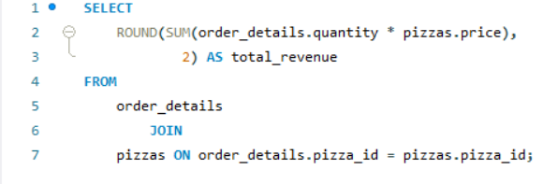
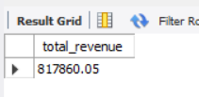
2- Calculate the Total Revenue Generated from Pizza Sales.

Slide 7
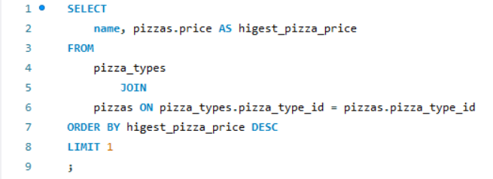
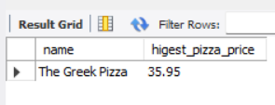
3- Identify the Highest-Priced Pizza.

Slide 8
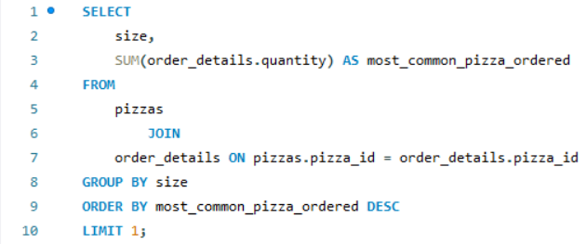
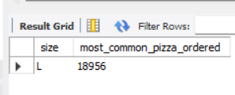
4 - Identify the most common pizza size ordered.

Slide 9
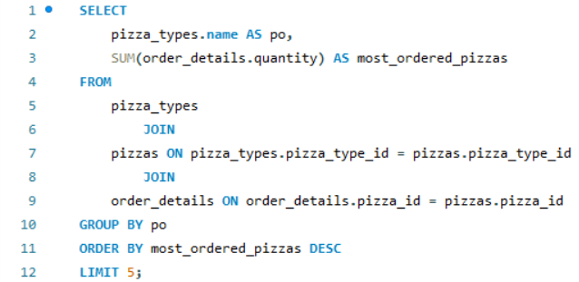
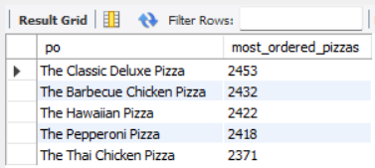
5 - List the top 5 most ordered pizza types along with their quantities.

Slide 10
Intermediate Queries

Slide 11
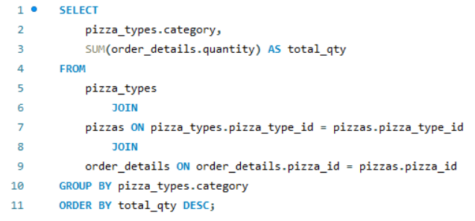
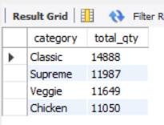
6 - Join The Necessary Tables To Find The Total Quantity Of Each Pizza Category Ordered.

Slide 12
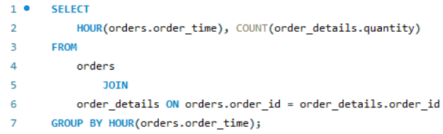
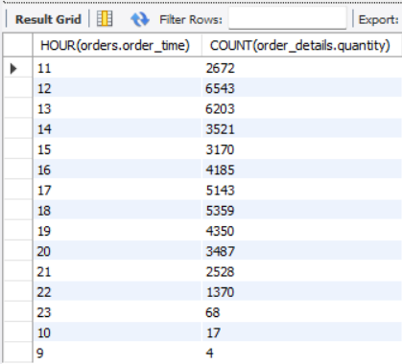
7- Determine the distribution of orders by hour of the day.

Slide 13
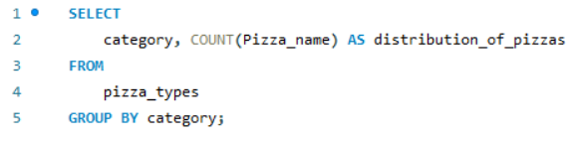
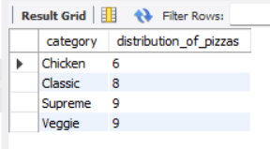
8 - Join relevant tables to find the category-wise distribution of pizzas.

Slide 14
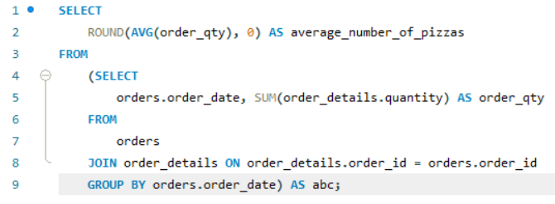
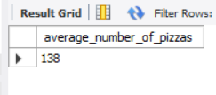
9 - Group the orders by date and calculate the average number of pizzas ordered per day.

Slide 15
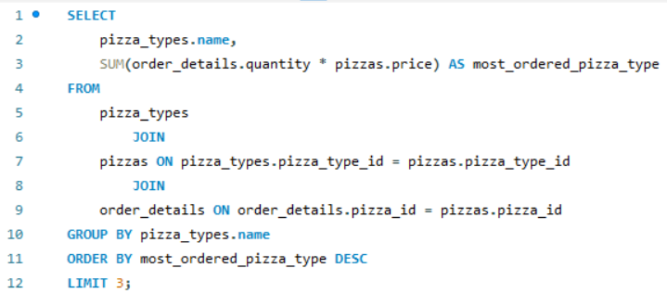
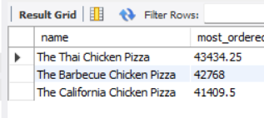
10 - Determine the top 3 most ordered pizza types based on revenue.

Slide 16
Advanced Queries

Slide 17
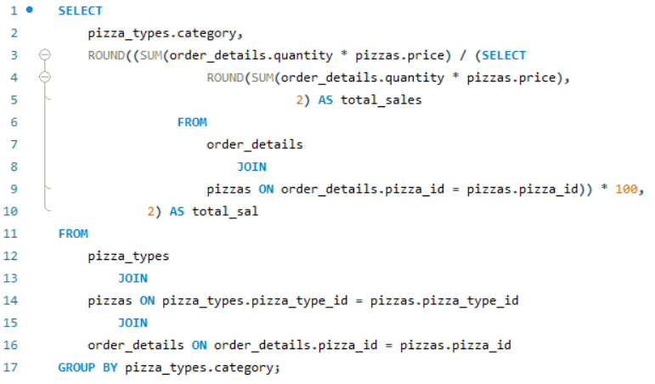
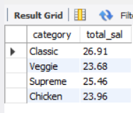
11 - Calculate the percentage contribution of each pizza type to total revenue.

Slide 18
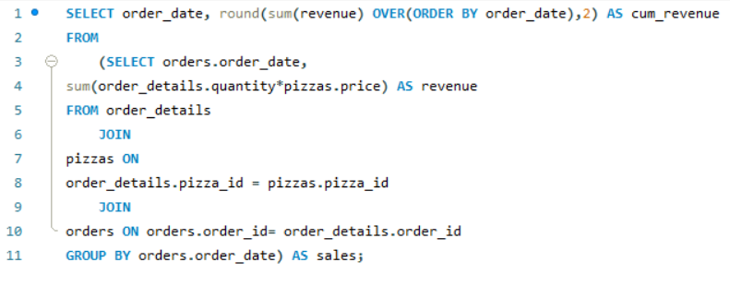
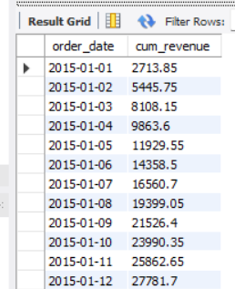
12 - Analyze the cumulative revenue generated over time.

Slide 19
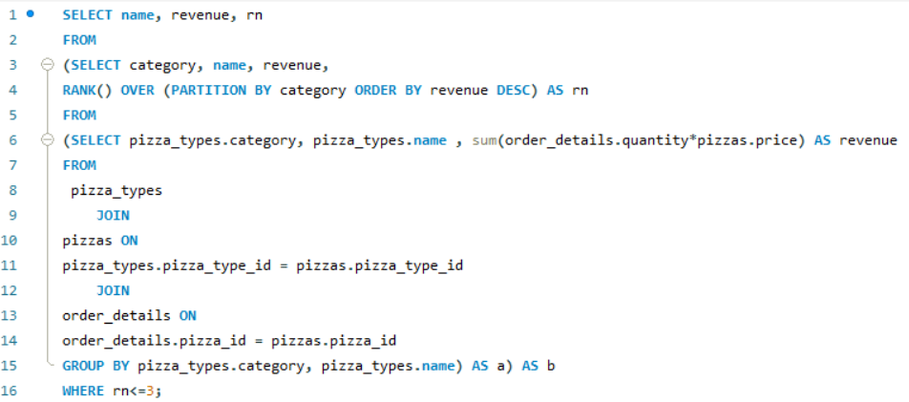
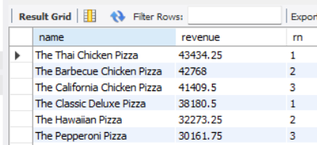
13 - Determine the top 3 most ordered pizza types based on revenue for each pizza category.

Slide 20
THANK YOU

